Slide 1
The Legend of Zorldo
Robert Davis, Richard Muri, Andrew Mele, Daniela Garcia

Slide 2
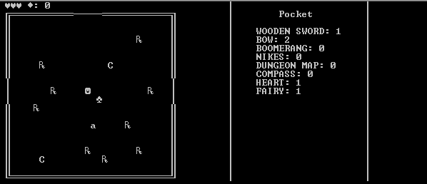
Major points
Our project was designed around a basic user interface.
Users can move using the arrow keys but still can enter commands using the keyboard
All items that are picked up are put in the pocket which is displayed on the right side of the UI
The recent commands are displayed using a queue

Slide 3
Basic gameplay
Lank begins in a dungeon and must fight his way to Ganondalf to rescue the Princess Zorldo.
He must stab, slash and …stab his way to victory
He can regain health from hearts and fairies.
He gets rupees from pots and chests; the more rupees he has the better

Slide 4
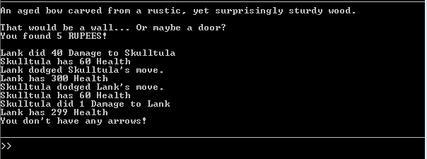
Command
Help – displays commands
Examine – examine a feature of the game
Use – use an item in your pocket
Open – opens chests or doors
Save – saves the current game
Load – loads the last game
Fight – fights the enemy …or pot in the given direction
Equip – equip item from pocket
Map – Displays a map of the dungeon, but only if you have the item

